Slide 1


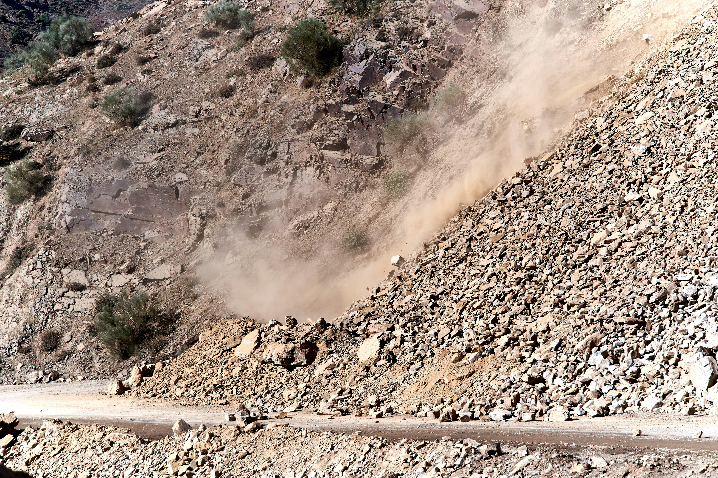
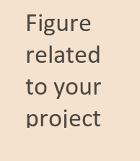
National Institute Of Technology Arunachal Pradesh
IoT based Landslide Early Warning System
Presented by
Guided by
Nishant Raj (ECE/20/16)
Ravi Raushan (ECE/20/27)
Vaibhav (ECE/20/34)
Dr. Alak Majumder
Assistant Professor ECE,NITAP
Submitted for the final year project
of
B.Tech
in
Electronics and Communication Engineering
Electronics and Communication Engineering
May-2024

Slide 2
Project Outline
Abstract
Objectives
Tools and Technology
System Architecture
Simulation of System
Data Collection and Graph
Conclusions
Future Scope
IoT based Landslide Early Warning System
May-2024
2

Slide 3
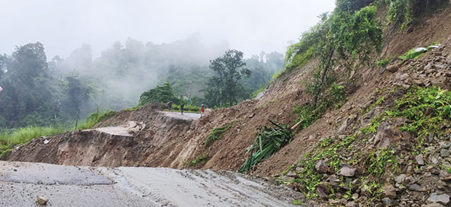
1. Abstract
A landslide is a common natural phenomenon that turns into a disaster when it comes into a human’s life.This is the event that can ruin anyone’s life especially in the mountain range.In this project,we have analyzed the event of landslide with various parameters and tried to label its danger level. We have used the different sensors to take the real time data input and convert it into a useful warning message that makes disaster management aware and relieves people by predicting their risk earlier.That’s why this system is known as the Early Warning System.
IoT based Landslide Early Warning System
May-2024
3

Slide 4
2. Objectives
To create a Landslide Early Warning System circuit.
Simulation of the integrated sensors for early warning system.
To notify alertness/danger level of the landslide.
To plot graph result of the danger level in accordance to the threshold values with respect to various sensor parameters.
IoT based Landslide Early Warning System
May-2024
4

Slide 5
3. Tools and Technology
Arduino Uno
It is a microcontroller board based on the ATmega328P IC.
Temperature Sensor LM35
It is 3-terminal linear temperature sensor ranging from -55°C to +150°C.
HL-83 Rain Sensor
The sensor is used to detect precipitation. It is powered with the voltage of 5 V.
Soil Moisture Sensor
A soil moisture sensor is a device used to measure the moisture content in the soil. Moisture is measured here in terms of %.
Vibration Sensor SW-420
It is used to measure mechanical vibration in various system. It detects and converts the mechanical motion or acceleration into an electrical signal that is used for our analysis.
LCD LM016L
It is a 16x2 character display, meaning it can display 16 columns and 2 rows of characters.
IoT based Landslide Early Warning System
May-2024
5

Slide 6
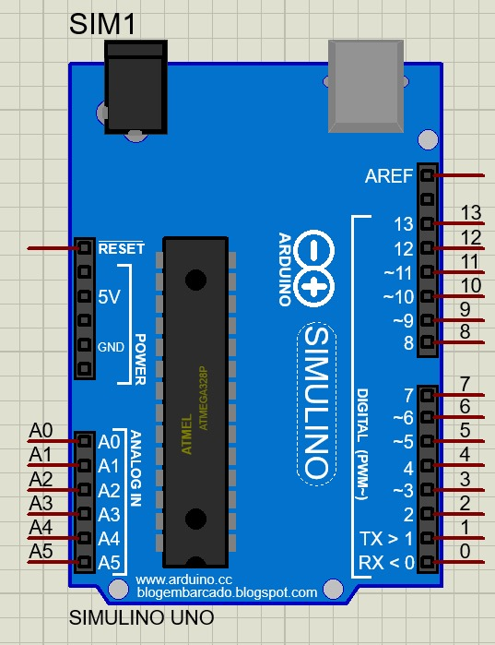
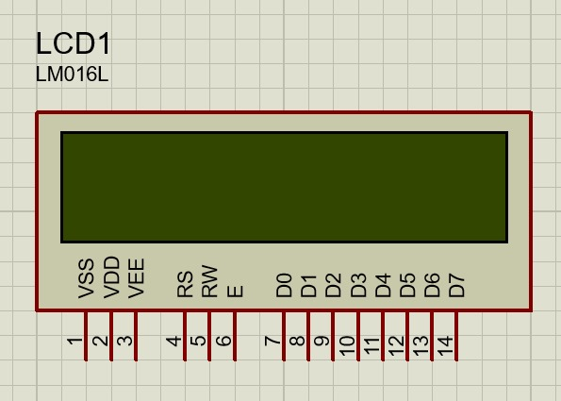
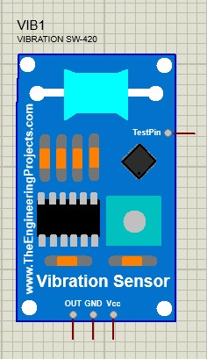
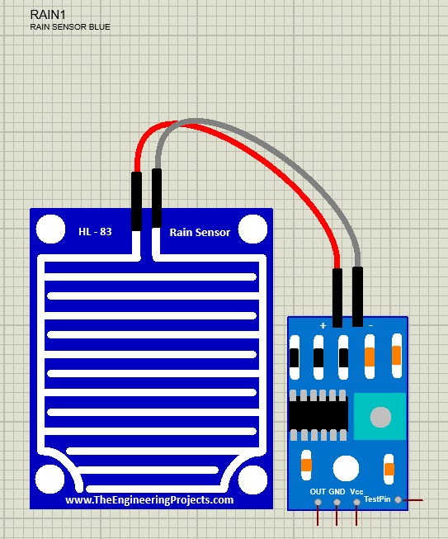
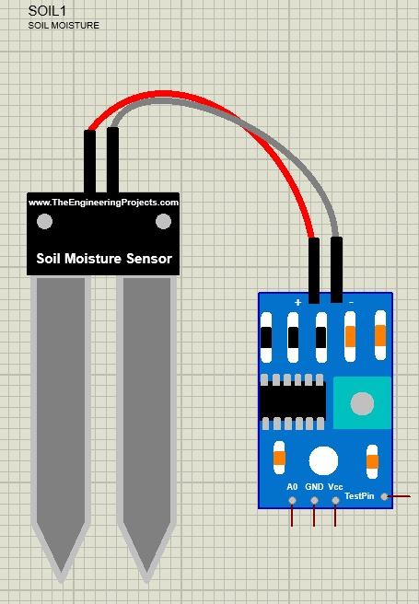
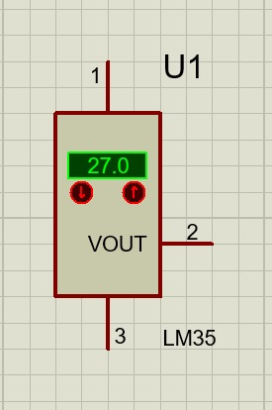
3.Tools and Technology
IoT based Landslide Early Warning System
May-2024
6

Slide 7
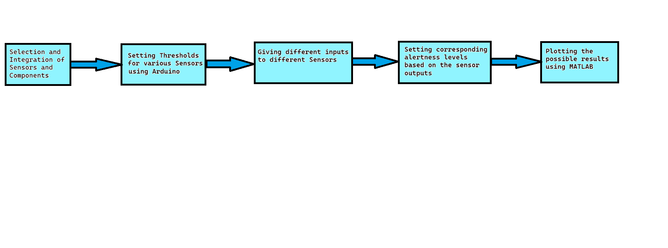
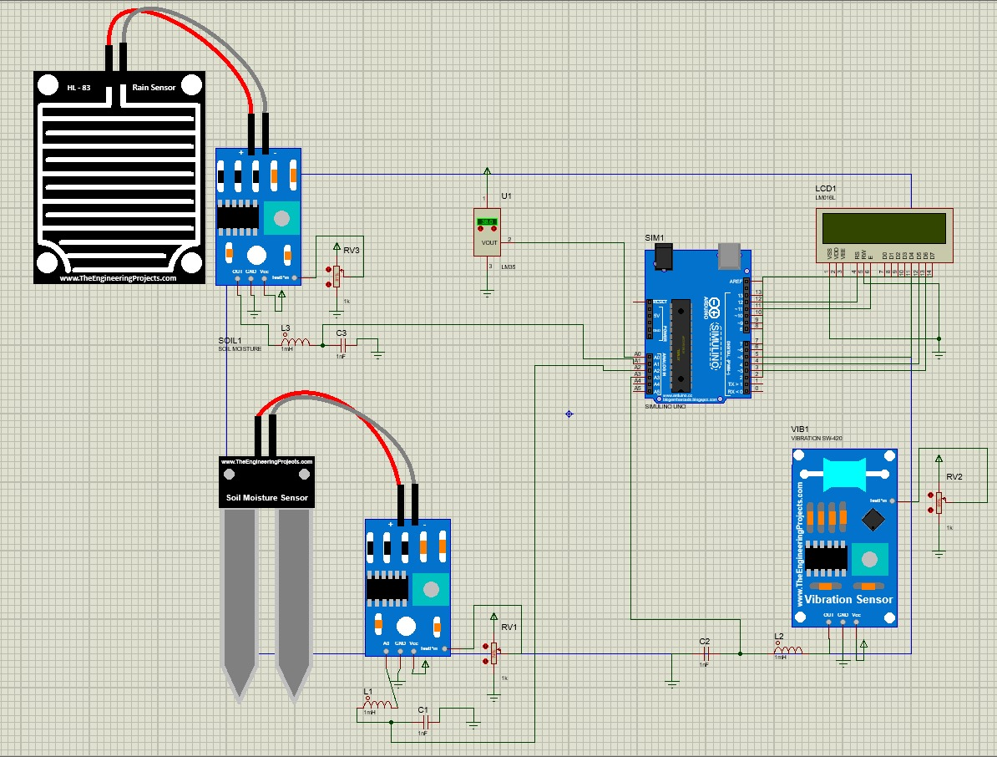
4. System Architecture
IoT based Landslide Early Warning System
May-2024
7

Slide 8
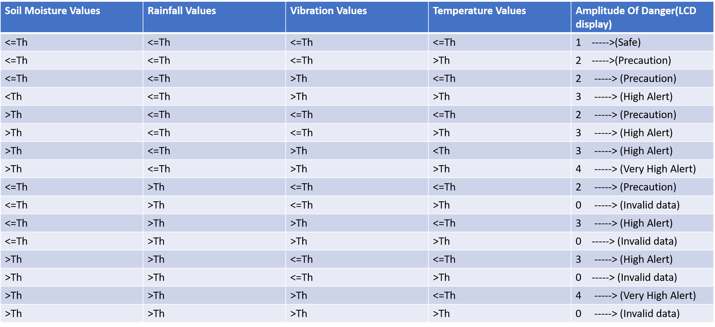
5. Simulation of System
The above is the System Architecture we have made for simulation in Proteus Software. Threshold value is going to decide about the danger level of the landslide probability. We have taken threshold value for each sensor that are as follows:
 | Soil Moisture (%) | Rainfall Sensor (arbitrary unit) | Vibration Sensor (arbitrary unit) | Temperature Sensor (°C)
Threshold Value | 60 | 500 | 550 | 45
IoT based Landslide Early Warning System
May-2024
8

Slide 9
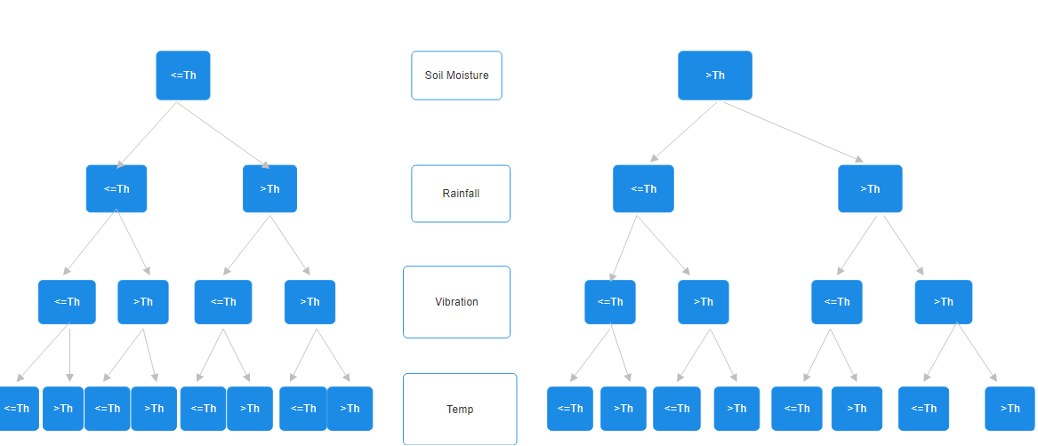
6. Data Collection and Graph
The threshold data for the parameter Soil Moisture,Rainfall,Vibration and Temp makes 16 cases for input data.
So, for each of the 16 cases we took the minimum and maximum possible value within that range. This makes 32 discrete input data for plotting bar graph in Matlab.
This will give us the idea of range of variation of input corresponding to the danger level of happening landslide.
IoT based Landslide Early Warning System
May-2024
9

Slide 10
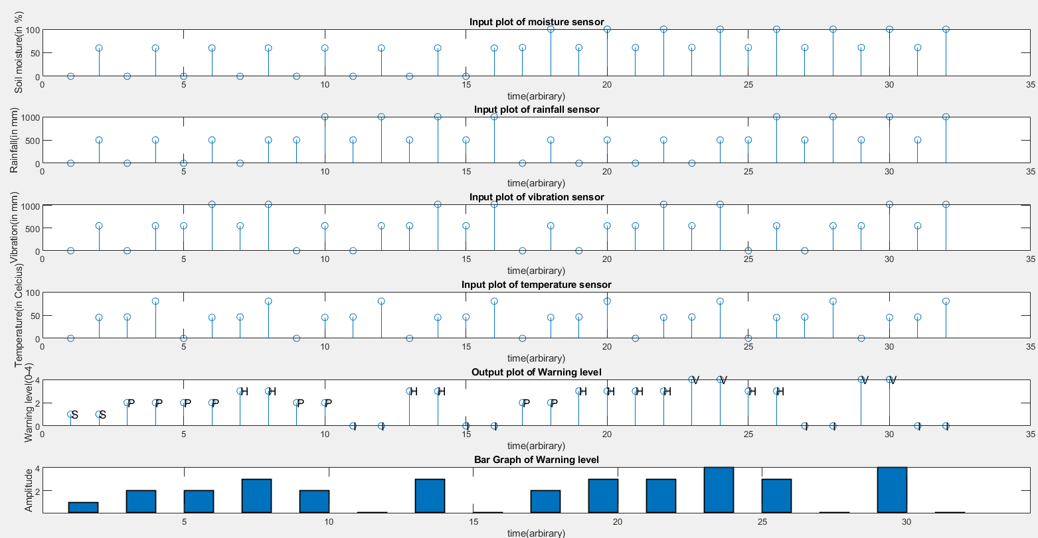
6. Data Collection and Graph
The 32 input data in all 16 cases taken are as:
[(0,0,0,0),(60,500,550,45)],[(0,0,0,46),(60,500,500,80)],[(0,0,551,0),(60,500,1023,45)],[(0,0,551,46),(60,500,102 3,80)],[(0,501,0,0),(60,1000,550,45)],[(0,501,0,46),(60,1000,550,80)],[(0,501,551,0),(60,1000,1023,45)],[(0,501, 551,46),(60,1000,1023,80)],[(61,0,0,0),(100,500,550,45)],[(61,0,0,46),(100,500,550,80)],[(61,0,551,0),(100,500, 1023,45)],[(61,0,551,46),(100,500,1023,80)],[(61,501,0,0),(100,1000,550,45)],[(61,501,0,46),(100,1000,500,80) ],[(61,501,551,0),(100,1000,1023,45)],[(61,501,551,46),(100,1000,1023,80)]
IoT based Landslide Early Warning System
May-2024
10

Slide 11
7. Conclusions
By integrating various sensors to Arduino board, we successfully completed and tested the circuit model of Landslide EWS.
We have established the alertness level corresponding to the outcomes from various sensors.
There are five alertness levels used to denote and generate outputs and graph, namely “Safe” (S), “Precaution” (P), “High Alert” (H), “Very High Alert” (V) and “Invalid data” (I).
We have plotted the magnitude of alertness level in bar graph through matlab.
IoT based Landslide Early Warning System
May-2024
11

Slide 12
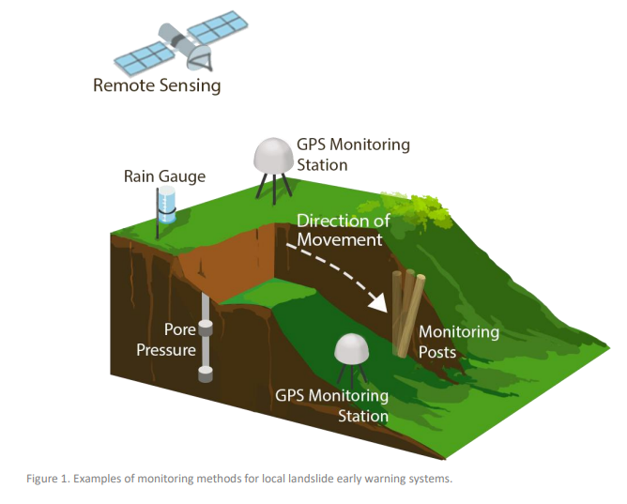
8. Future scope
Paswan et al. (2023) [1] developed early warning system, designed for identifying impending slope failures, utilized a combination of tilt angle and moisture content variations. Through continuous monitoring, the system observed a gradual shift in the tilt angle of the slope over a two-hour period, displaying a variation ranging from approximately 0.5 degrees to 1.5 degrees. This specific range can be served as a predefined warning threshold.
We can also consider the parameters like monitoring of slopes, humidity etc for better accuracy.
It would be valuable to account for variations in geotechnical and hydrological characteristics.
The efficiency of model can be increased by considering appropriate priorities e.g. priority of vibration sensor is greater than temperature.
IoT based Landslide Early Warning System
May-2024
12

Slide 13
References
Abhishek Prakash Paswan et al. (2023) [1] , RAINFALL INDUCED LANDSLIDE - DETECTION AND DEVELOPMENT OF EARLY WARNING SYSTEM
Ngawang Galley , Tashi Yangzom , Ugyen Tshering , Kamal K. Chapagai (2016) [2] WIRELESS SENSOR NETWORK BASED LAND SLIDE DETECTION AND EARLY WARNING SYSTEM.
https://www.theengineeringprojects.com/2020/07/soil-moisture-sensor-library-for-proteus.html, for sensor hex files.
IoT based Landslide Early Warning System
May-2024
13

Slide 14


